Slide 1
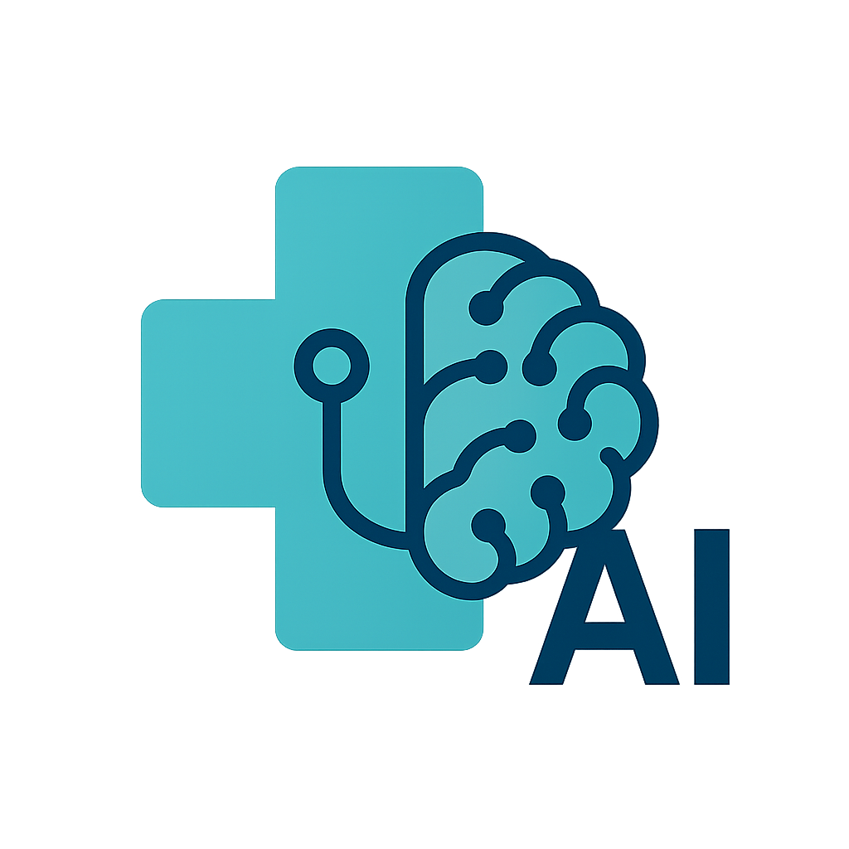
Med-assist ai
Smarter hospital flow, with AI at your side.

Slide 2
PROBLEM
Beds stay full longer than needed
Discharge decisions often happen hours, sometimes days later than medically necessary.
Delays create downstream overload
ERs and other wards back up when patients can't be transferred or admitted in time.
Nurses rely on manual tracking
Staff must monitor dozens of patients and detect readiness by memory or notes.
Doctors agree: this is a real need
We spoke with hospital staff who confirmed the pain and said they’d use this today.

Slide 3

INSIGHTS FROM prof. Michael rosenberg
Q: Does delayed discharge impact hospital flow? A: “Yes, absolutely.”
Q: How many staff members, on average, take part in the decision to release a single patient and how long does it take? A: “It depends on the treating doctor’s decision, but usually the treating doctor, attending nurse and head nurse…. It takes at least 3-4 hours a day… just to get an evaluation”
Q: Are all clinical patient data fully documented in EMR system? A: “Yes, all of it.”

Slide 4
SOLUTION
INTELLIGENT DECISIONS
SIMPLE
AI predicts discharge readiness and detects department overloads in real-time.
Nurses and staff receive mobile-friendly alerts and clear, explainable suggestions.
CLINICALLY SAFE
IMMEDIATE IMPACT
Built with full transparency, data security, and real clinical input.
Can reduce patient stay hours and free up beds starting from day one.

Slide 5
PRODUCT OVERVIEW
MONITORS HOSPITAL LOAD
Continuously tracks ward occupancy, staffing levels, and alerts on overload.
PREDICTS PATIENT DISCHARGES
Analyzes vitals, history, and treatments to flag patients likely ready to go home.
NOTIFIES THE RIGHT STAFF
Sends real-time alerts to nurses and doctors with explainable recommendations.
INFORMS PATIENT FAMILIES
Offers a secure, AI-powered chat that answers common status questions.

Slide 6
WHERE WE USE AI
DISCHARGE PREDICTION
Trained ML model analyzes vitals, history, and treatment response to flag readiness.
STAFF REALLOCATION SUGGESTIONS
AI detects overloaded wards and suggests where backup staff can be pulled from.
PATIENT FAMILY CHAT
LLM-based assistant answers common questions securely, using filtered EMR data.
EXPLAINABLE INSIGHTS
All AI decisions are accompanied by visible rationale and supporting data based on past decisions and doctors' affirmations.

Slide 7
DEMO

Slide 8
AI & DATA ETHICS
Privacy by Design
We work only with de-identified data - no personal identifiers used.
Human-in-the-Loop
The AI offers suggestions - final decisions stay with clinical staff.
Doctor-Approved Approach
Prof. Rosenberg confirmed that such a system is viable without patient identifiers.

Slide 9




MEET THE TEAM
Nitzan Ventura
Noam Shabat
Shay Morad
Samuel Hayat
Computer Science B.Sc. Student
Computer Science B.Sc. Student
Computer Science B.Sc. Student
Computer Science B.Sc. Student

Slide 10
SUMMARY
MedAssist AI is a hospital assistant built to tackle one of the most pressing challenges in healthcare - delayed patient discharge. By combining real clinical insights, live hospital data, and AI-powered reasoning, we help hospitals detect overloads, suggest early discharges, and notify staff in real time. Our tool is safe, explainable, and ready to make an immediate operational impact. With MedAssist AI, hospitals can improve patient flow, reduce staff strain, and give families peace of mind.

Slide 11
THANK YOU
Thank you for your time and attention. We welcome your feedback, questions, and collaboration.

